Slide 1
Analyzing Aftershock Sequences in Bogo City, Cebu using Unsupervised and Supervised Learning
Charrie Anne S. Nacor
Joanna Marie M. Pagtalunan

Slide 2
Introduction & Problem Statement
On September 30, 2025, a deathly magnitude 6.9 earthquake struck offshore near Bogo City, Cebu, in an area previously considered a low-risk due to low seismic activity over the past 400 years.
Problem Statement: The rupture revealed a previously unidentified fault system –Bogo Bay Fault-- highlighting the need for detailed post-event analysis to better understand its geometry and seismic activity.
Research Hypothesis: The aftershock sequence of the 2025 Bogo City earthquake contains distinct, separable clusters driven by differences in location, depth, magnitude, and timing. These clusters will exhibit high separability under supervised models (SVC and XGBoost), thereby validating the feature-importance patterns observed in the unsupervised analysis.

Slide 3
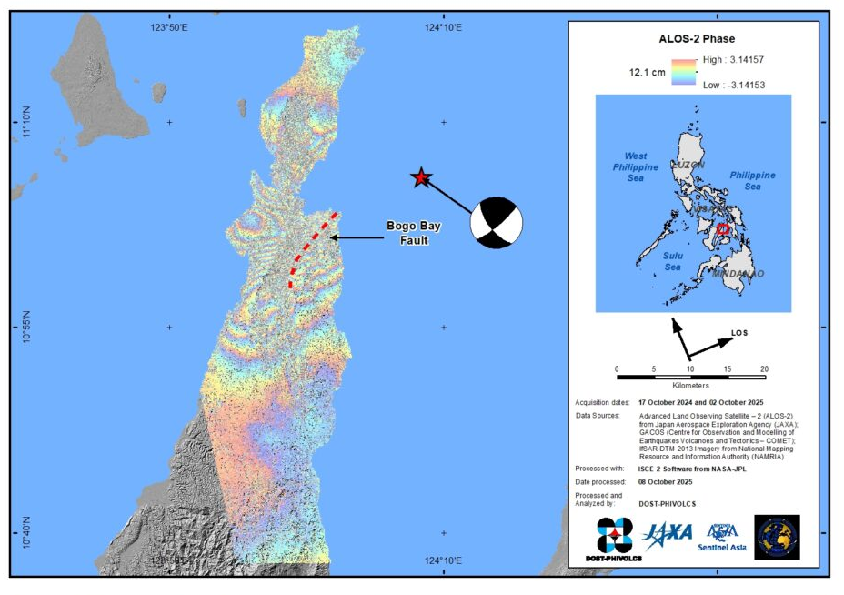
Introduction & Problem Statement
The 6.9 magnitude earthquake exposed a previously unknown fault, the Bogo Bay Fault.
Satellite Image of the Surface rupture of the Bogo Bay Fault during the 2025 Magnitude 6.9 Northern Cebu
Retrieved from: https://www.phivolcs.dost.gov.ph/satellite-image-of-the-surface-rupture-of-the-bogo-bay-fault-during-the-2025-magnitude-6-9-northern-cebu/

Slide 4
3,050 aftershocks were recorded within a month.

Slide 5
Can we identify distinct, meaningful clusters within this aftershock sequence to better understand the seismic activity?

Slide 6
Our Approach: A two-step methodology
Unsupervised Learning
Supervised Learning
Identify natural groupings in the data
Validate if these groupings are meaningful and well-separated

Slide 7
Our Approach: A two-step methodology
Unsupervised Learning
Supervised Learning
K-Means
K-Medoids
SVM
XGBoost
Clustering Algorithms
Classification Algorithms

Slide 8
Methodology
Dataset
Unsupervised Learning
Supervised Learning
K-means
Cluster Characteristics
SVM
Pre-processing
K-medoids
Train/Test
70-30
XGBoost
EDA

Slide 9
Step 1: Unsupervised Learning

Slide 10
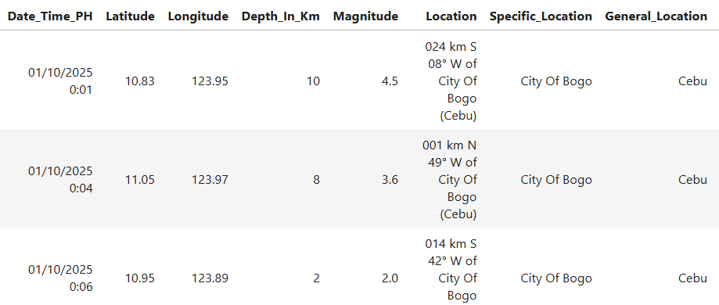
PHIVOLCS recorded 3,050 earthquakes in Bogo City, Cebu, from October 1-30, 2025, with magnitudes ranging from 1.0 to 5.8 and depths from 1 to 60 km.

Slide 11
Is our data even clusterable?

Slide 12
Is our data even clusterable?
We used the Hopkins Statistic to assess clustering tendency.

Slide 13
Is our data even clusterable?
We used the Hopkins Statistic to assess clustering tendency.
Result
0.9994
H > 0.5, which means the data has a significant tendency to cluster.

Slide 14
Methodology
Dataset
Unsupervised Learning
Supervised Learning
K-means
Cluster Characteristics
SVM
Pre-processing
K-medoids
Train/Test
70-30
XGBoost
EDA
Diagnostic Metrics
Hopkins Statistic
Elbow Method
Silhouette Score

Slide 15
We need to find the best ‘k’ for our clustering algorithms.
We used the Elbow Method, which plots the within-cluster variance against the number of clusters.

Slide 16
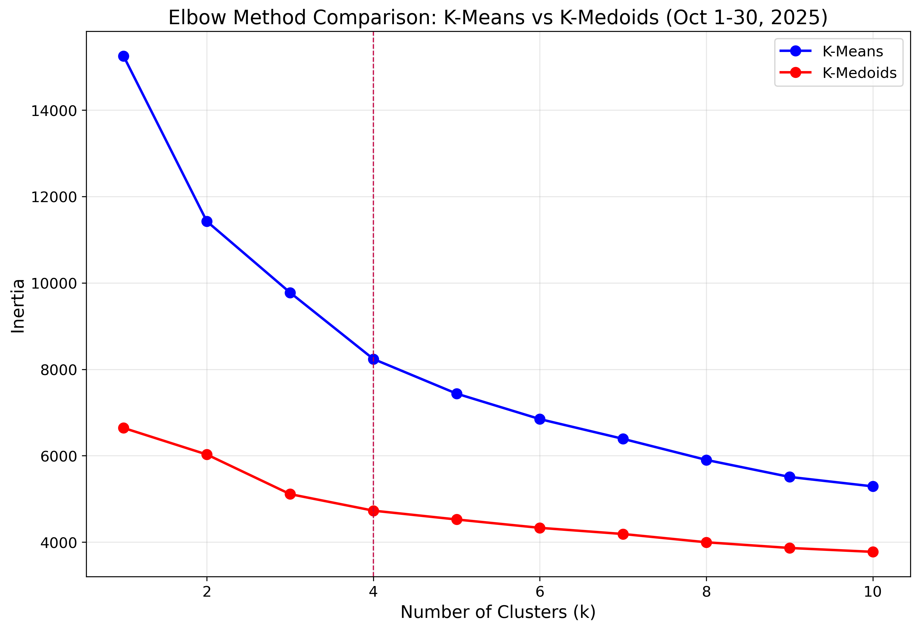
This suggests that four is the most natural number of clusters in the data.

Slide 17
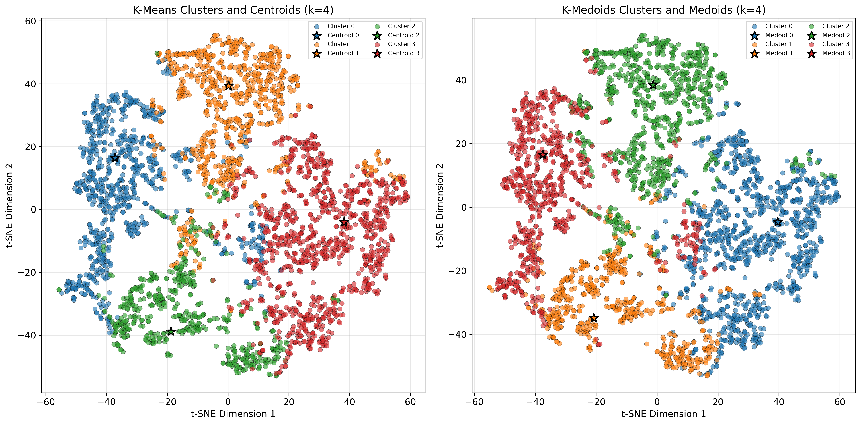
Silhouette Score = 0.2373, Time = 0.0057s
Silhouette Score = 0.2353, Time = 3.4539s

Slide 18
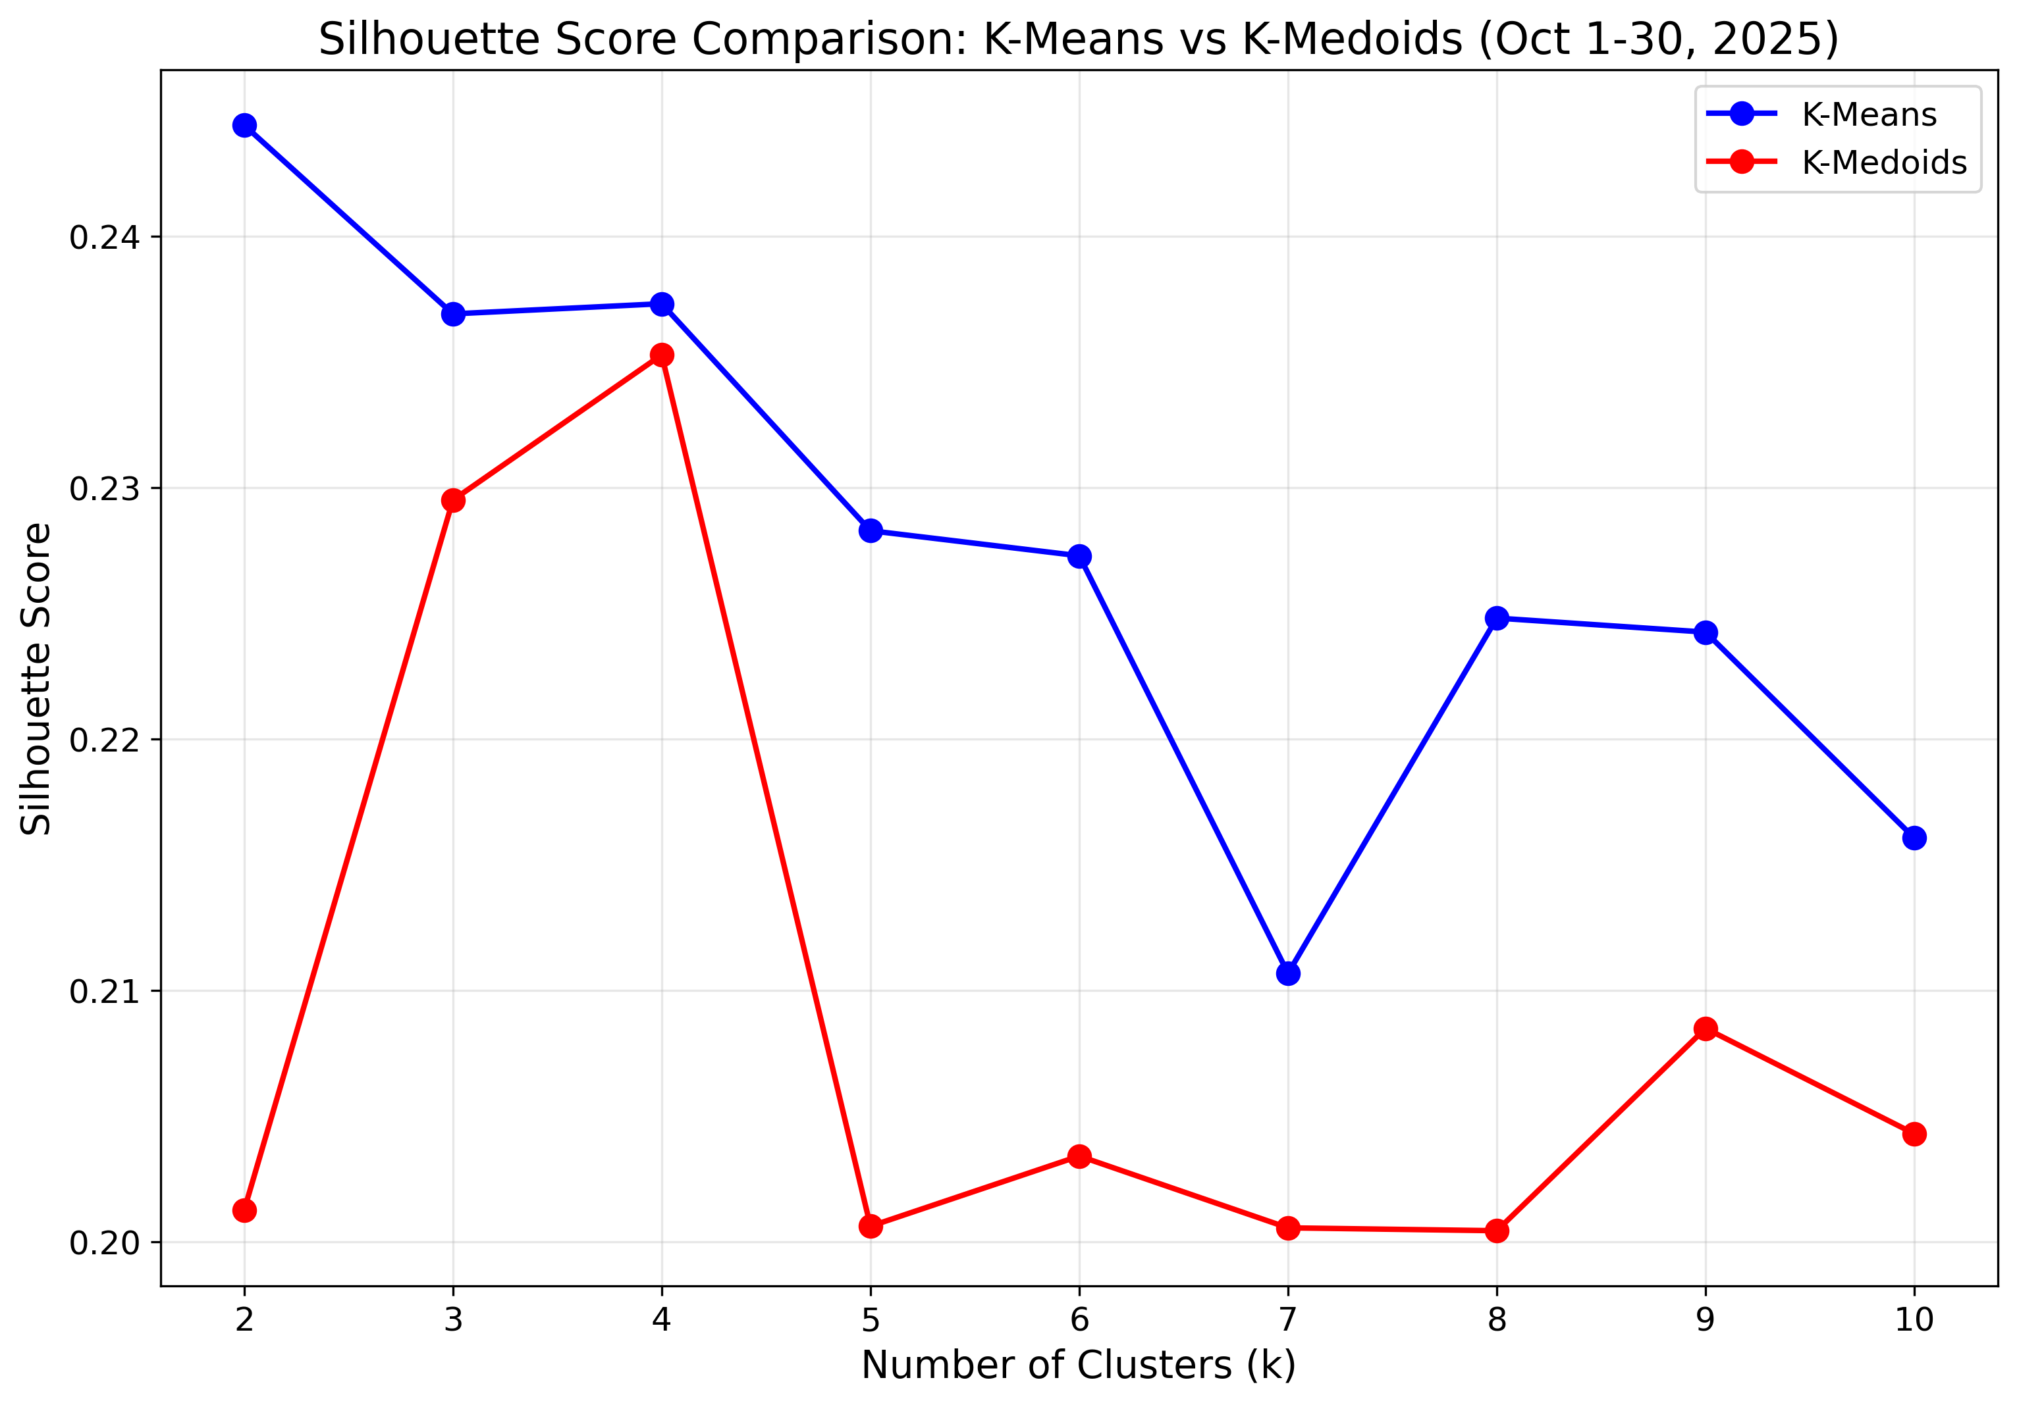

Slide 19
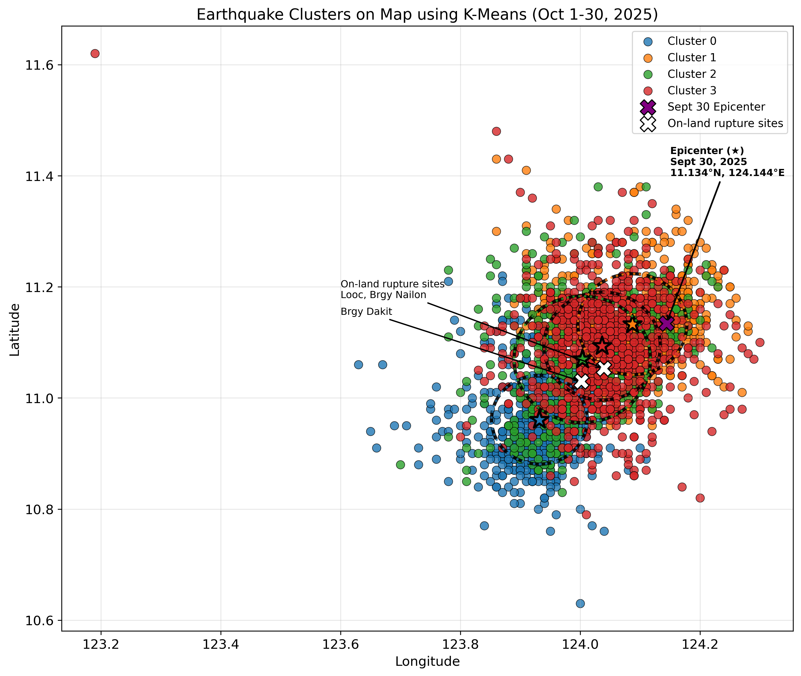
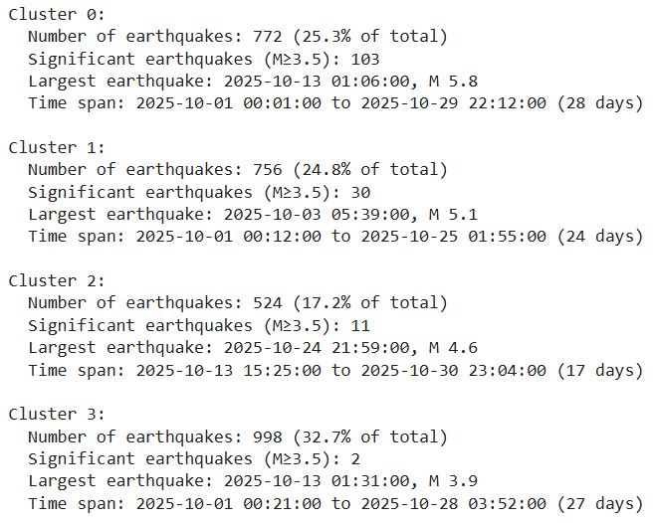
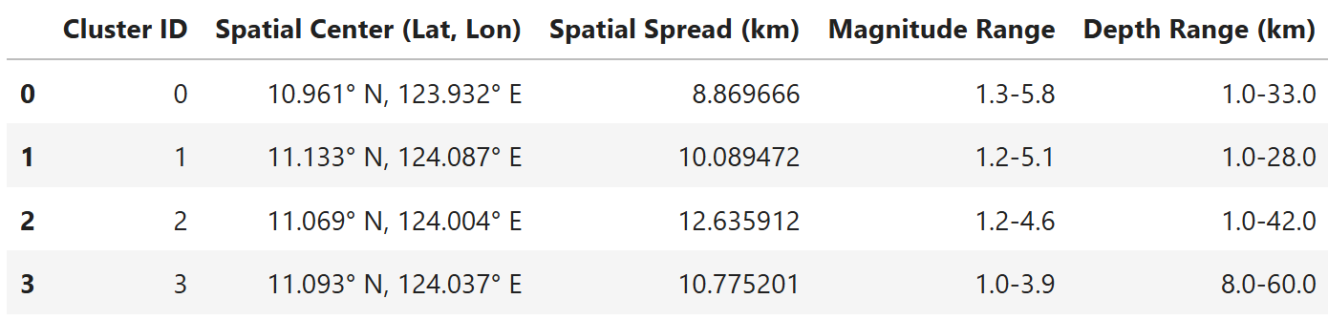

Slide 20
Step 2: Supervised Learning

Slide 21
Test if the clusters identified by K-Means are truly meaningful and well-separated.
Train classifiers to predict the cluster label of an earthquake based on its features.

Slide 22
Methodology
Dataset
Unsupervised Learning
Supervised Learning
K-means
Cluster Characteristics
SVM
Performance Metrics
Pre-processing
K-medoids
XGBoost
Classification Report
Train/Test
70-30
EDA
Diagnostic Metrics
Hyperparameter Tuning
Hopkins Statistic
Elbow Method
Silhouette Score
GridSearchCV

Slide 23
70%
training set
30%
test set

Slide 24
Hyperparameter Tuning using GridSearchCV
SVC
XGBoost
C: 0.1, 1, 10, 100
gamma: 1, 0.1, 0.01, 0.001
kernel: rbf, poly, linear
3-fold cross validation
max_depth: 3, 5, 7
min_child_weight: 1, 3, 5
learning_rate: 0.01, 0.1, 0.2
subsample: 0.8, 0.9, 1.0
colsample_bytree: 0.8, 0.9, 1.0
3-fold cross validation

Slide 25
Best Parameters
SVC
C: 100
gamma: 1
kernel: linear

Slide 26
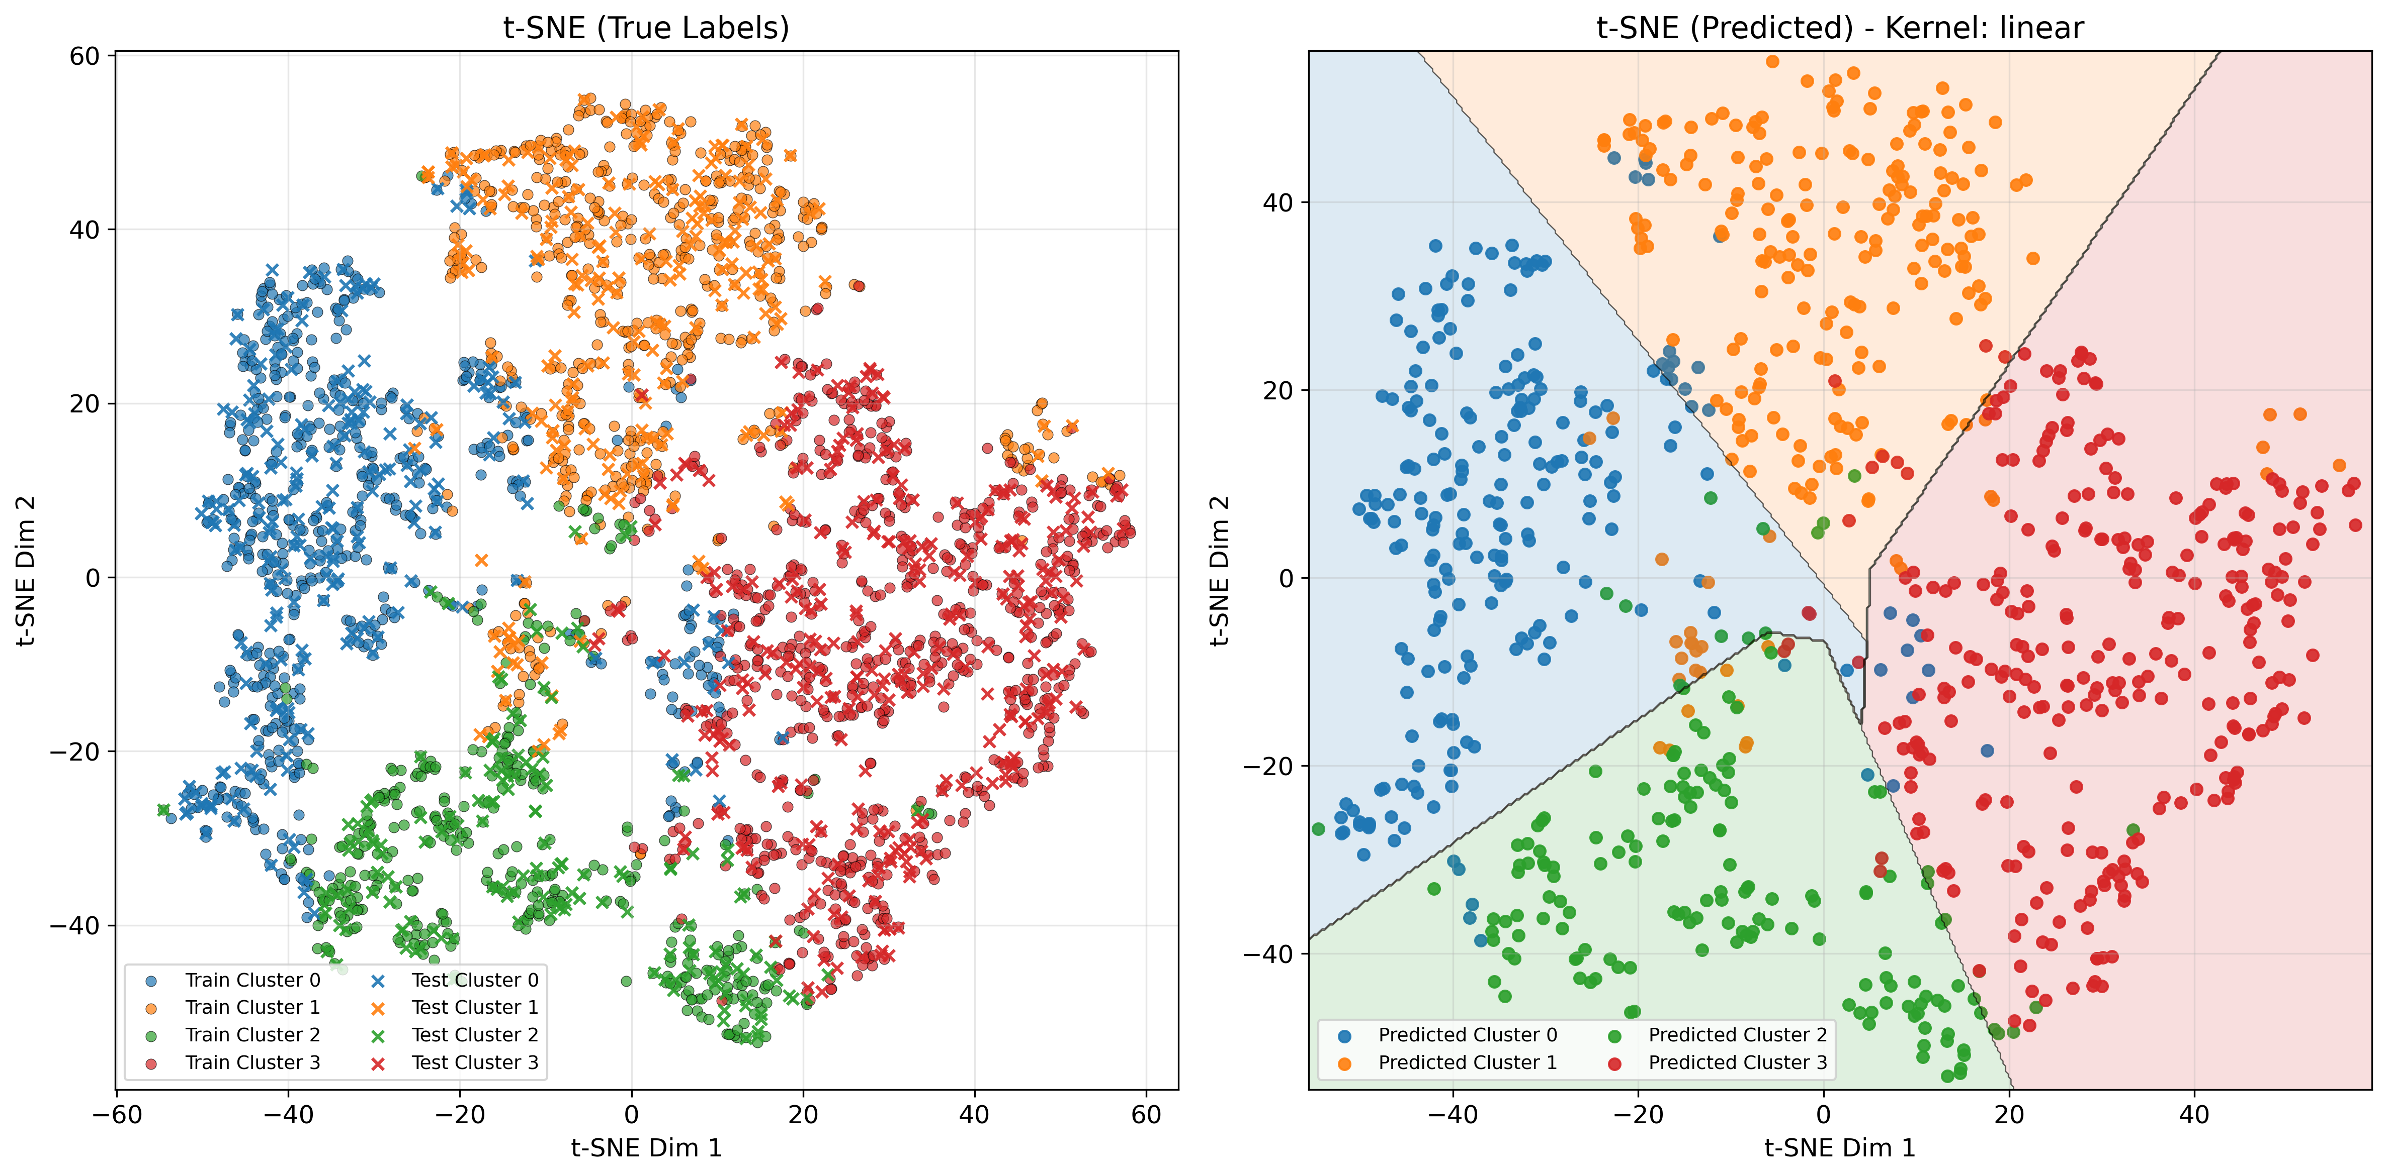

Slide 27
Best Parameters
XGBoost
max_depth: 5
min_child_weight: 5
learning_rate: 0.2
subsample: 0.8
colsample_bytree: 0.8

Slide 28
SVC Classification Report
Class | Precision | Recall | F1-Score | Support
0 | 1.00 | 0.99 | 0.99 | 232
1 | 1.00 | 0.99 | 0.99 | 227
2 | 0.97 | 0.99 | 0.98 | 157
3 | 1.00 | 0.99 | 0.99 | 299
Accuracy |  |  | 0.99 | 915
Macro Avg | 0.99 | 0.99 | 0.99 | 915
Weighted Avg | 0.99 | 0.99 | 0.99 | 915
Test Accuracy: 0.9913
Cross-validation Score: 0.9892

Slide 29
XGBoost Classification Report
Class | Precision | Recall | F1-Score | Support
0 | 0.97 | 0.96 | 0.97 | 232
1 | 0.95 | 0.93 | 0.94 | 227
2 | 0.93 | 0.96 | 0.94 | 157
3 | 0.97 | 0.97 | 0.97 | 299
Accuracy |  |  | 0.9585 | 915
Macro Avg | 0.95 | 0.96 | 0.96 | 915
Weighted Avg | 0.96 | 0.96 | 0.96 | 915
Test Accuracy: 0.9585
Cross-validation Score: 0.9550

Slide 30
Best Model: SVC

Slide 31
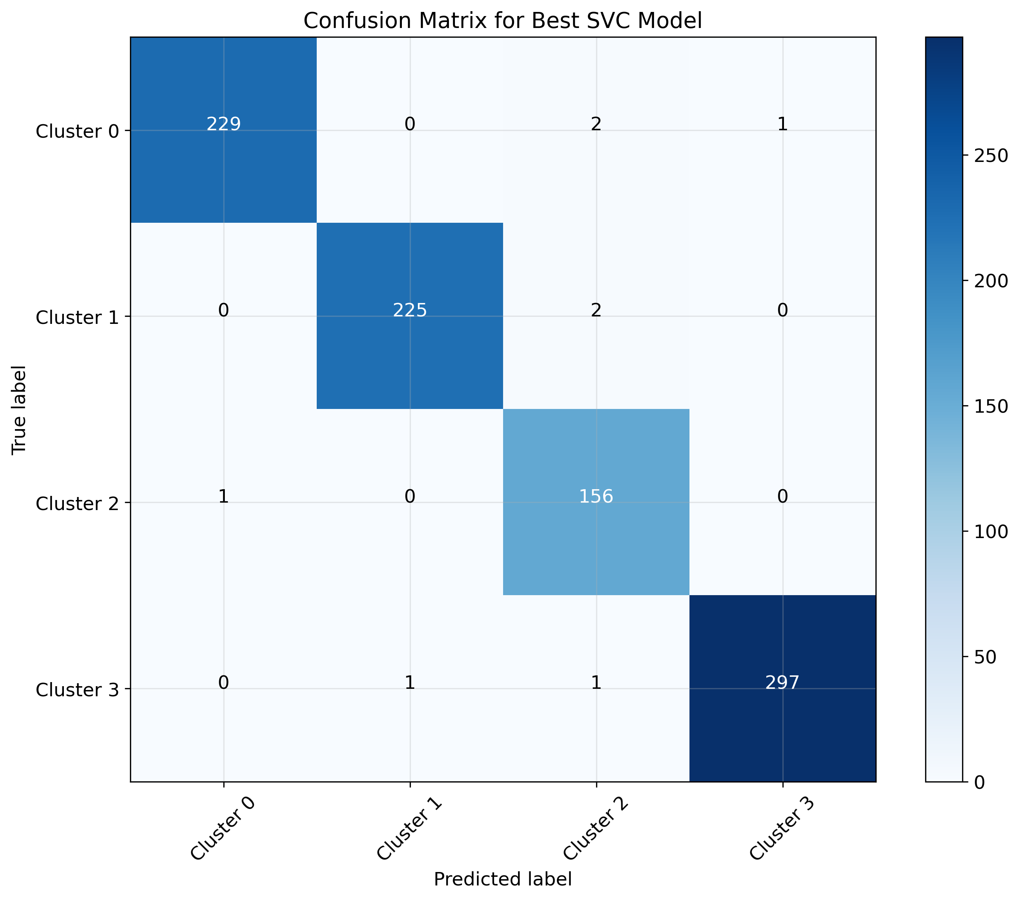
Among 915 earthquake samples in the test set,
Cluster 0:
229 samples correctly identified
Actual Count: 232
Cluster 1:
225 samples correctly identified
Actual Count: 227
Cluster 2:
156 samples correctly identified
Actual Count: 157
Cluster 3:
297 samples correctly identified
Actual Count: 299

Slide 32
Conclusion

